Slide 1
Microwave Components-2

Slide 2
Directional Coupler
A Directional coupler is a device that samples a small amount of Microwave power for measurement purposes. The power measurements include incident power, reflected power, VSWR values etc. Directional coupler is used to couple the Microwave power which may be uni-directional or bi-directional. It is a 4 port waveguide junction consisting of a Primary main waveguide and a Secondary auxiliary waveguide.

Slide 3
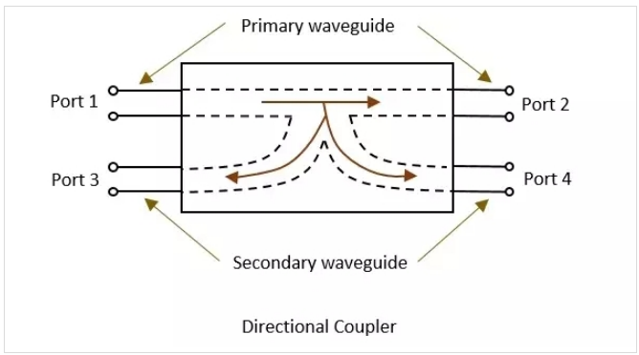

Slide 4
Directional Coupler
It is a four-port device where Port 1 is the incident port, Port 2 is the through port (because it connects via a straight line). Port 4 is the coupled port, and Port 3 is the isolated port.
Alternatively, a signal can be incident on Port 2, so Port 1 is the through port, Port 3 is the coupled port, and Port 4 is the isolated port.

Slide 5
Properties
The properties of an Ideal directional coupler are as follows:
All the terminations are matched to the ports.
When the power travels from port 1 to port 2, some portion of it gets coupled to port 4 but not to port 3.
As it is also a bi-directional coupler when the power travels from port 2 to port 1, some portion of it gets coupled to port 3 but not to port 4.
If the power is incident through port 3, a portion of it is coupled to port 2, but not to port 1.
If the power is incident through port 4, a portion of it is coupled to port 1, but not to port 2.
Port 1 and 3 are decoupled as are port 2 and port 4.
Ideally, the output of port 3 should be zero. But, practically, a small amount of power called back power is observed at port 3.

Slide 6
Primary Parameters
Most microwave devices, S-parameters are needed to characterize the performance fully. The basic specifications are similar to those of other microwave components. Assuming Port 1 is the incident port, then there Insertion Loss (IL) between Port 1 and Port 2; Isolation (I – the ratio of incident power to the back-reflected power) between Port 1 and Port 3; Coupling (C – the ratio of incident power to the forward power) between Port 1 and Port 4; and Directivity (D – the ratio of forward power to the back power) between Port 4 and Port 3; all are expressed in dB, of course.

Slide 7
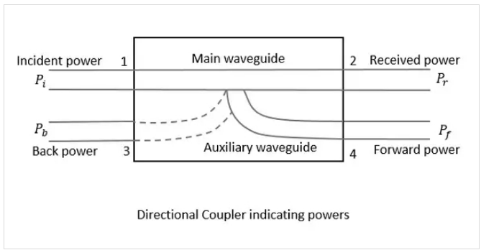
Power Flow in the Directional Coupler
IL
I
C
D

Slide 8
How is a directional coupler actually built?
There are two common ways: using waveguides or using transmission lines. A basic waveguide coupler uses precisely spaced and sized holes which are a function of wavelength and bandwidth (and the holes may have non-round shapes) to allow power to flow between two physically aligned waveguides. As a result, incident energy on Port 1 mixes with energy incident on Port 3.

Slide 9
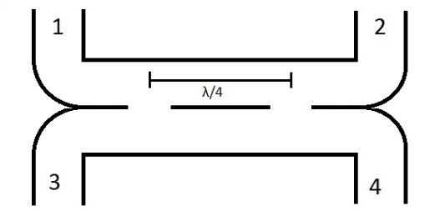

Slide 10
Two-Hole Directional Coupler
This is a directional coupler with same main and auxiliary waveguides, but with two small holes that are common between them. These holes are a λg/4 distance apart where λg is the guide wavelength.
A two-hole directional coupler is designed to meet the ideal requirement of the directional coupler, which is to avoid back power. The power while travelling between port 1 and port 2, some of it escapes through the holes 1 and 2. The magnitude of the power depends upon the dimensions of holes. This leakage power at both the holes is in phase at hole 2, adding up the power contributing to the forward power Pf. But it is out of phase at hole 1, cancelling each other and preventing the back power to occur.
Hence the directivity of a directional coupler gets improved with two-hole directional coupler.

Slide 11
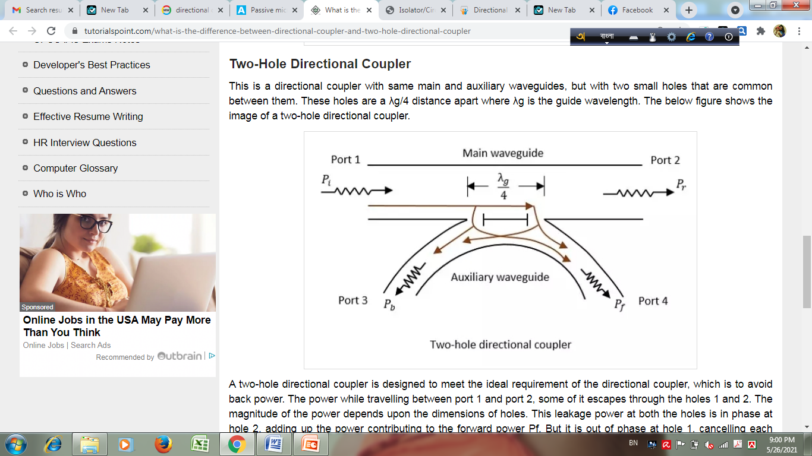

Slide 12
Home Work
Difference between Directional Coupler and two-hole directional coupler?

Slide 13
Isolator

Slide 14
Isolator
Isolator is a non-reciprocal device that allows light to pass along a fiber in one direction and offers very high attenuation in the opposite direction. Isolators are needed in the optical system to prevent unwanted reflections. In manufacturing isolators “Faradays Effect” is used, which is polarization dependent.
Isolators are constructed using optical polarizers, analyzers and Faradays rotator. The optical signal passes through the polarizer, oriented parallel to the incoming state of polarization. Faradays rotator will rotate the polarization of optical signal by 45 degrees.
The signal then passes through the analyzer, which is oriented at 45 degrees with respect to the input polarizer.
The isolator passes an optical signal from left to right and changes its polarization by 45 degrees and produces about 2 dB loss.

Slide 15
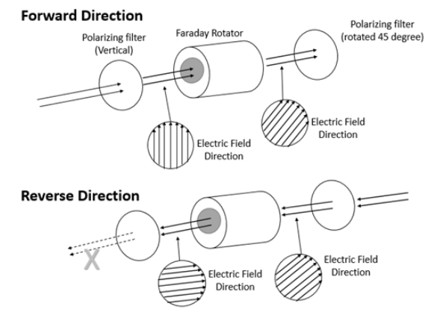

Slide 16
Isolator
An isolator is a circulator but has only 2 ports that transfer a signal, while the third has a termination resistor that is connected to ground. Think of it as a dumpster for unwanted signal. It protects RF components from excessive signal reflection.
If signal from port A is well matched with port B, the signal will go into port B with minimal loss. If they are not matched the signal will pass to port C, which will dissipate the signal into heat. Since port A is the input and port B is output, you don’t want anything bouncing back from port B back into A, as this will distort the signal or damage the port.

Slide 17
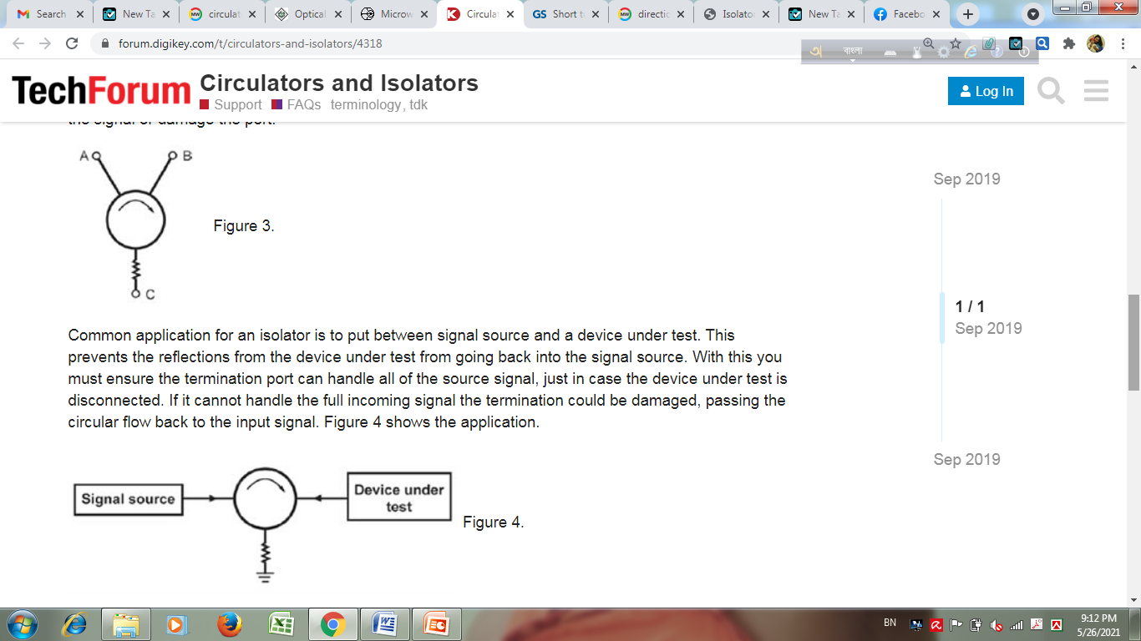

Slide 18
Isolator
Common application for an isolator is to put between signal source and a device under test. This prevents the reflections from the device under test from going back into the signal source. With this you must ensure the termination port can handle all of the source signal, just in case the device under test is disconnected. If it cannot handle the full incoming signal the termination could be damaged, passing the circular flow back to the input signal.

Slide 20
Circulator

Slide 21
Circulator
Circulators are micro-optic devices and can be used with any number of ports, however, commonly 3 ports/4 ports circulators are used. It has a relatively low loss 0.5 dB to 1.5 dB port-to-port.
The basic function of a circulator is light entering any particular port (say port 1) travels around the circulator and exits at the next port (say port 2). Light entering at port 2 leaves at port 3, and so on. The device is symmetric in operation around a circle.

Slide 22
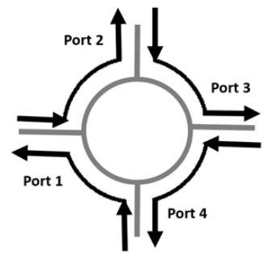

Slide 23
Circulator
Circulators help direct the flow of microwave or radio-frequency signals in RF systems. Usually 3 or 4-port device that transmits input signal from 1 port to the next. The ports are either input signal, output signal or termination and typically have a line impedance of 50Ω. Common connectors are SMA or N-type coaxial. The signal will transfer from port 1 to 2, 2 to 3, and 3 to 1. The ports are connected to a symmetrical Y junction that is coupled with magnetically biased ferrite material. Ferrite along with a magnet creates a flow that helps push the signal in the circular path and ensure the port-to-port assignments are followed. Circulators are designed to have minimal loss when transmitting an input signal from one port to the next.

Slide 24
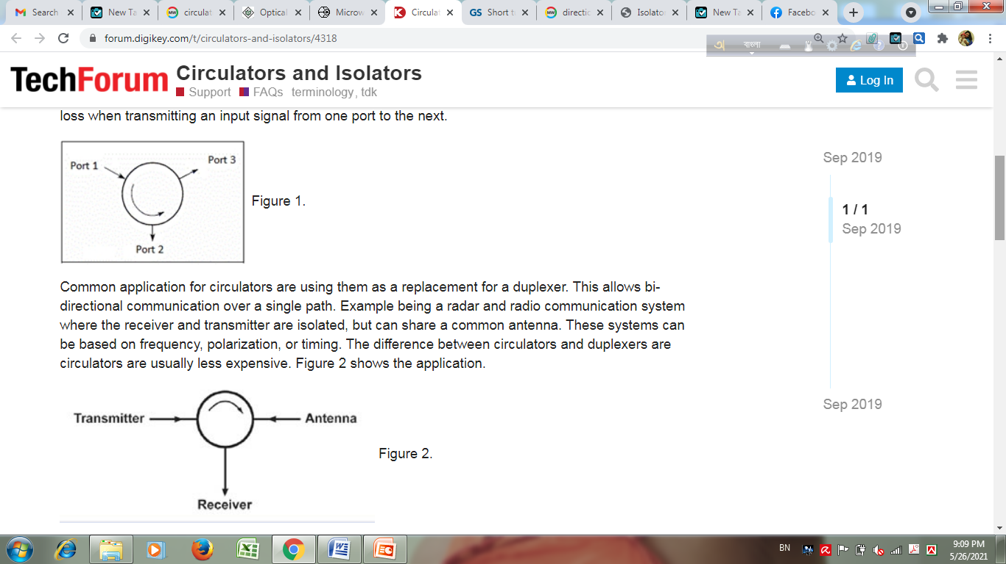
symmetrical Y junction

Slide 25
Circulator
Common application for circulators are using them as a replacement for a duplexer. This allows bi-directional communication over a single path. Example being a radar and radio communication system where the receiver and transmitter are isolated, but can share a common antenna. These systems can be based on frequency, polarization, or timing. The difference between circulators and duplexers are circulators are usually less expensive.

Slide 27
Phase Shifter

Slide 28
Phase Shifter
Phase shifters are used to change the transmission phase angle of a two-port network.
Characteristics:
Insertion loss (or gain): Ideally, phase shifters provide low insertion loss in all phase states. While the loss of a phase shifter is often overcome using an amplifier stage, lower insertion loss phase shifters require less amplification and lower power to overcome the losses.
Equal amplitude for all phase states: Many systems using phase shifters must not experience amplitude changes in signal level as phase states are changed.
Reciprocal networks: This means they work effectively on signals passing through them in either direction.
They provide flat phase versus frequency, or true time delay.

Slide 29
Home Work
Phase shifter.

Slide 30
Home Work
Comparison among isolator, circulator and phase shifter.

